Slide 1
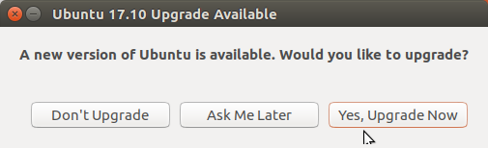
Ubuntu Unity Online Upgrade from 17.04 to 17.10
Waikato Linux Users Group
23 October 2017
Ian Stewart
Screenshots from performing the upgrade

Slide 2
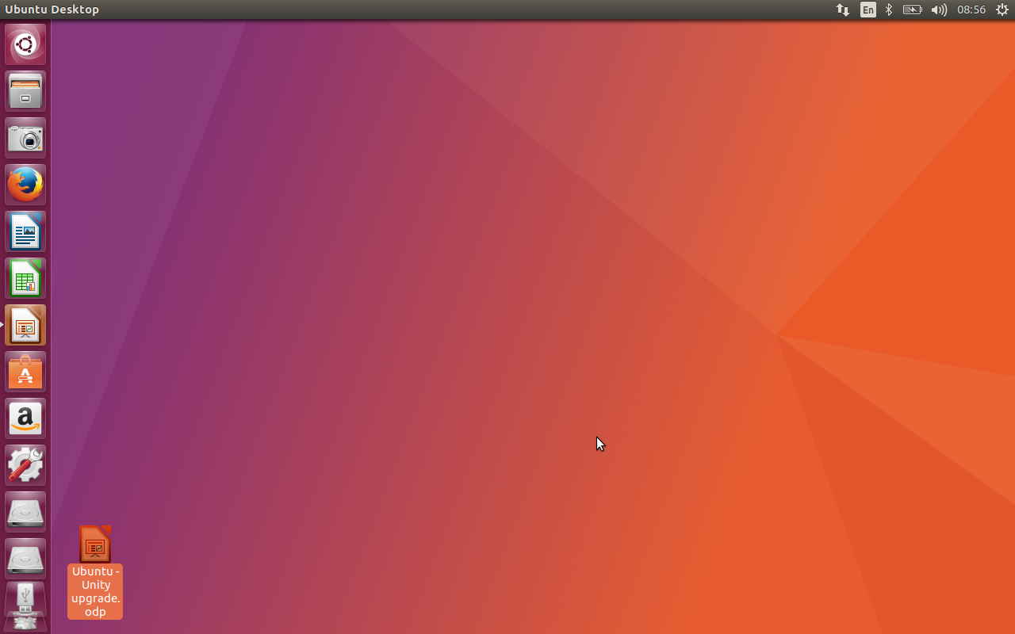
Ubuntu – 17.04 to 17.10
Ubuntu Unit 17.04 Xorg Desktop

Slide 3
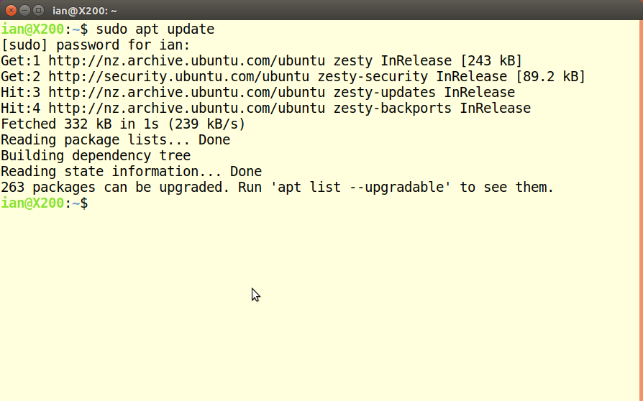
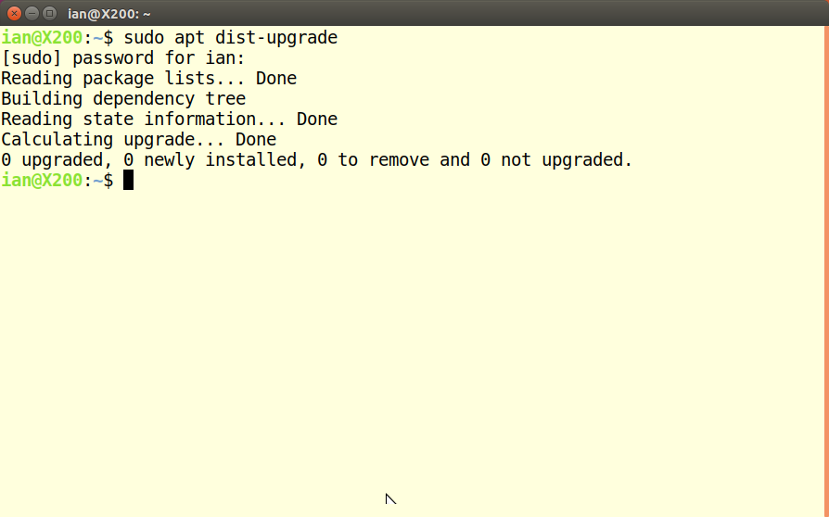
Ubuntu – 17.04 to 17.10

Slide 4
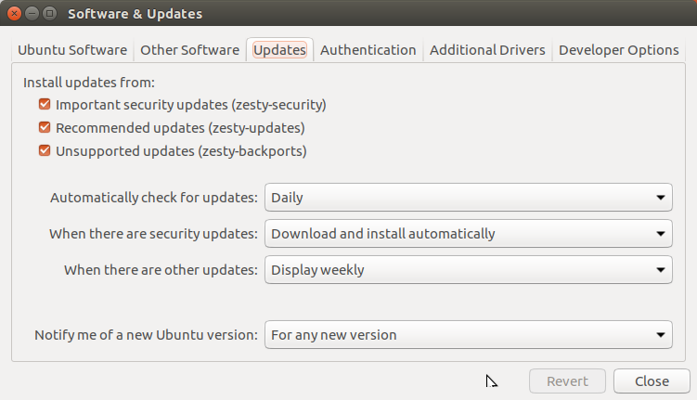
Ubuntu – 17.04 to 17.10

Slide 5
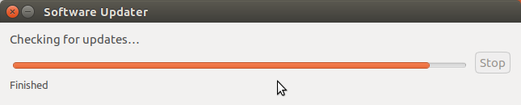
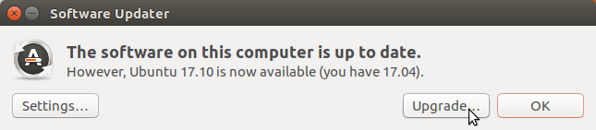
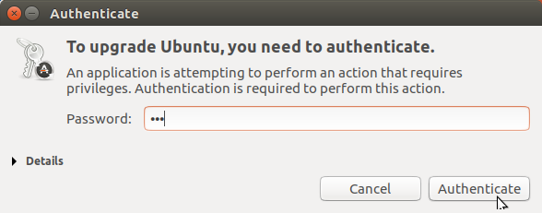
Ubuntu – 17.04 to 17.10

Slide 6
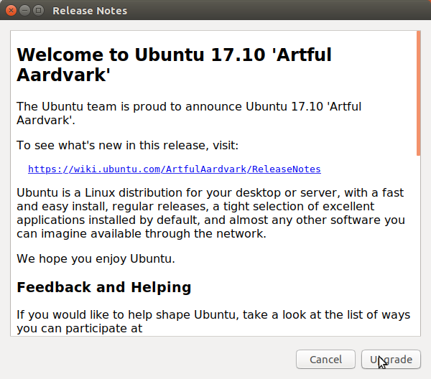
Ubuntu – 17.04 to 17.10

Slide 7
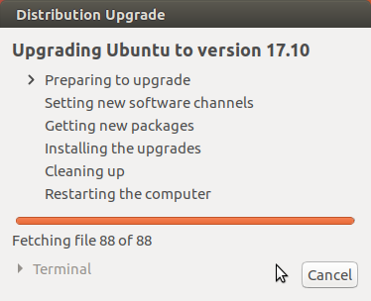
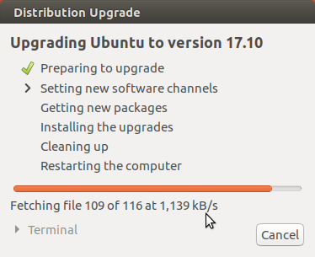
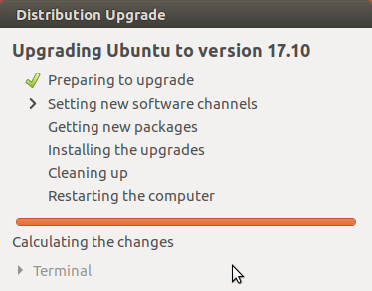
Ubuntu – 17.04 to 17.10

Slide 8
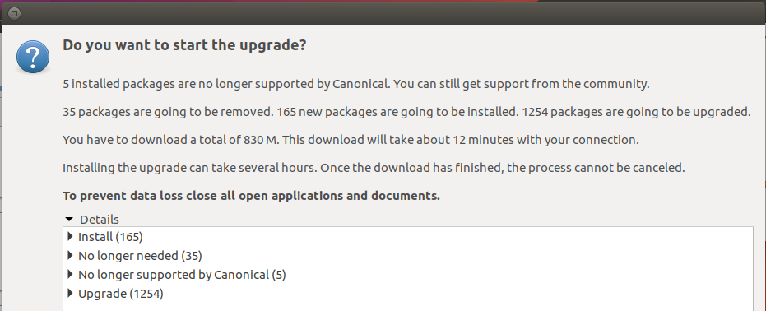
Ubuntu – 17.04 to 17.10

Slide 9
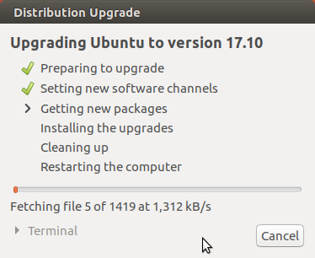
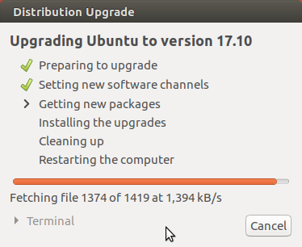
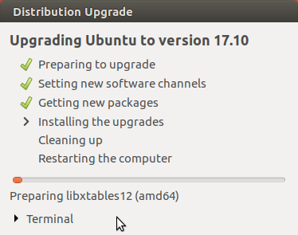
Ubuntu – 17.04 to 17.10

Slide 10
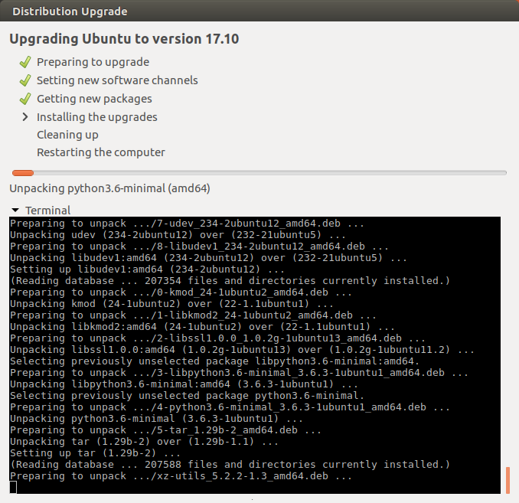
Ubuntu – 17.04 to 17.10

Slide 11
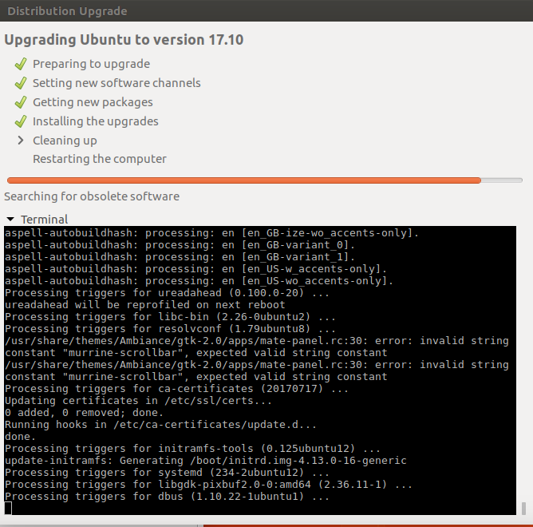
Ubuntu – 17.04 to 17.10

Slide 12
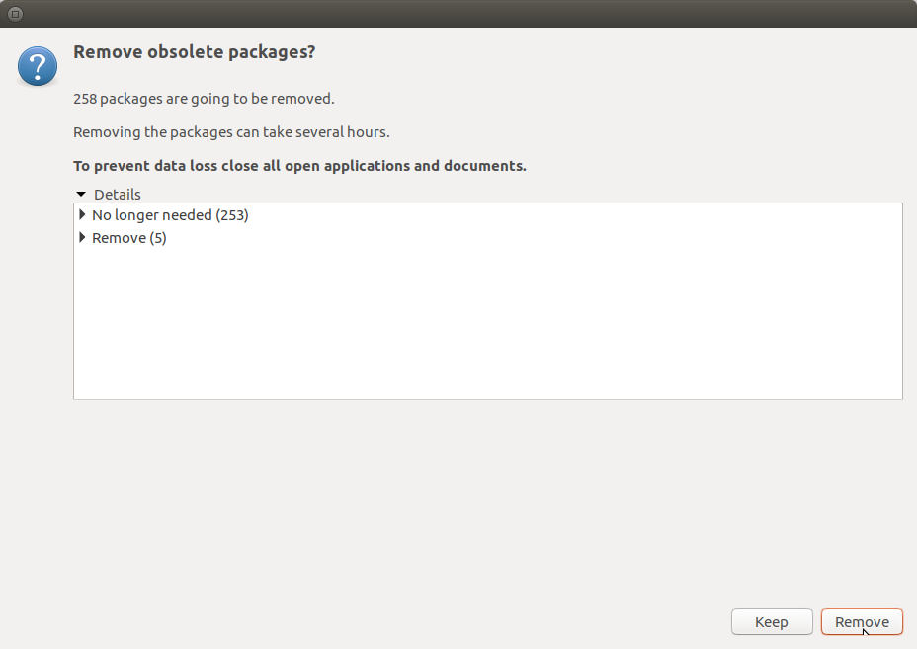
Ubuntu – 17.04 to 17.10

Slide 13
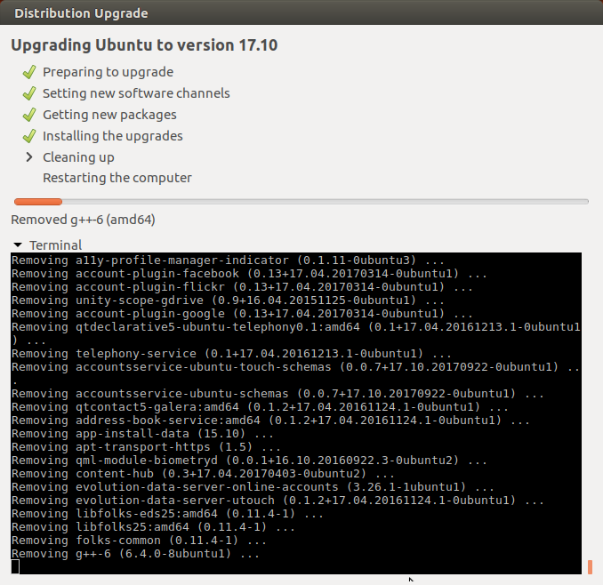
Ubuntu – 17.04 to 17.10

Slide 14
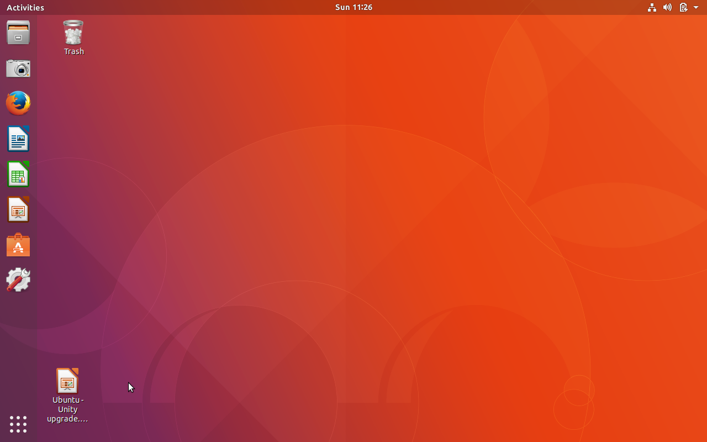
Ubuntu Gnome3 – 17.10 - Wayland
At the login menu you get the choices of:
Ubuntu: Gnome3 / Wayland
Ubuntu: Gnome3 / Xorg
Ubuntu: Unity / Xorg?

Slide 15
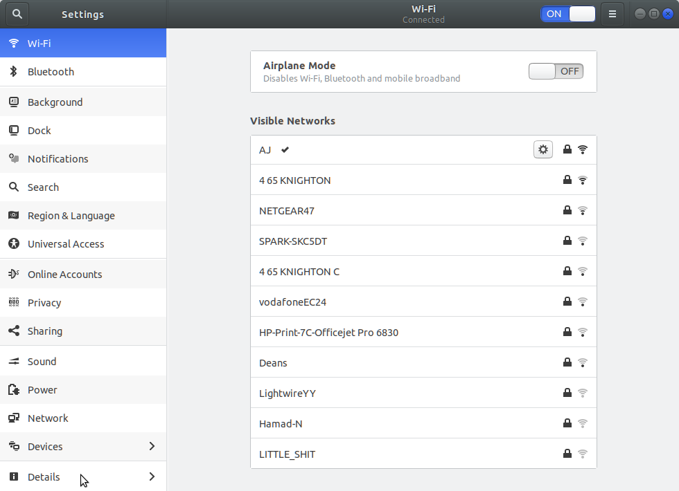
Ubuntu Gnome3 – 17.10 - Wayland
Upgrade:

Slide 16
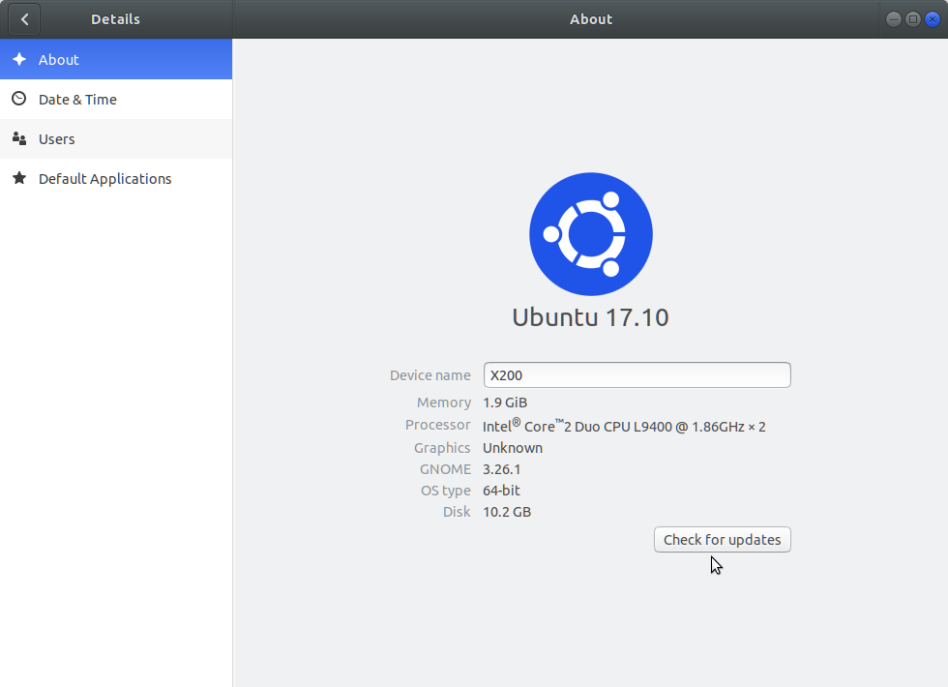
Ubuntu Gnome3 – 17.10 - Wayland
Upgrade:
Huh? Screenshot is showing blue when it should be orange?

Slide 17
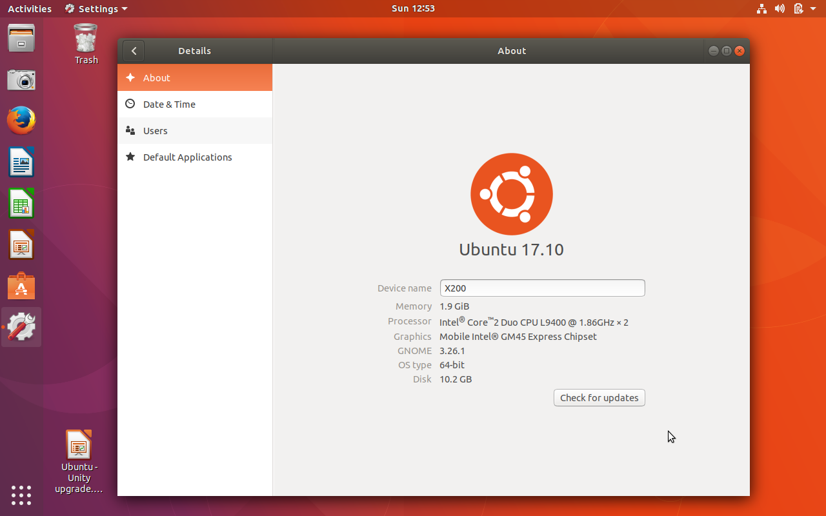
Ubuntu Gnome3 – 17.10 - Xorg
Screenshot is correct colour

Slide 18
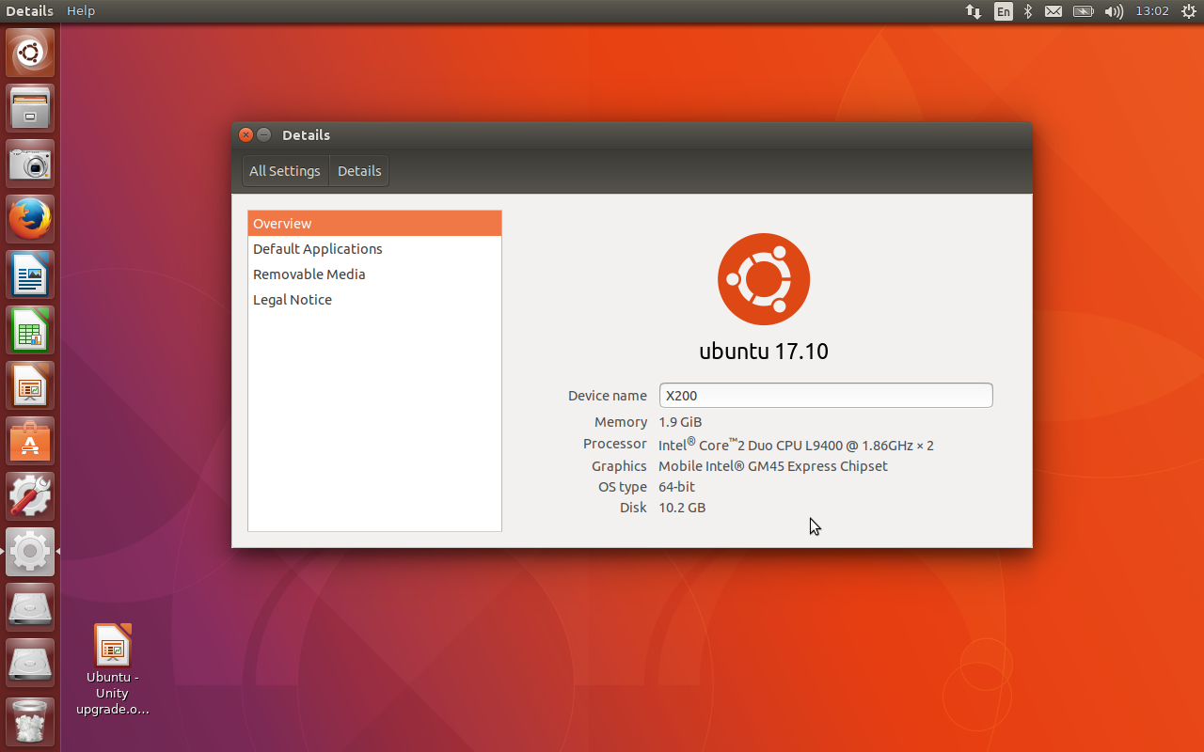
Ubuntu Unity 17.10
Screenshot is correct colour

Slide 19
Ubuntu – 17.10 - Demo

